Slide 1
Indoor Localization, Tracking and Navigation
Prof. Gary Chan
Department of Computer Science and Engineering
The Hong Kong University of Science and Technology
22 August 2012

Slide 2
Project Background
Successful outdoor Location-Based Services (LBS) based on GPS
Many indoor LBS with important business applications or lucrative commercial potentials
Airport
Large, complex and irregular area
Help tourists to
find their departure gates after check-in
transit flights from one gate to another
shop or find lounges while waiting for flights
Mall
Help customers to find shops
Location-based advertisement
Etc.

Slide 3
Meeting the Localization Challenges
Indoor localization is technically challenging
Absence of GPS
Lack of accurate indoor localization techniques
Lack of a unified indoor map API
Must be beyond just “digital map”
“smart guide”
Help visitors to know where they are
Direct them to go anywhere

Slide 4
Innovating a WiFi-Based Indoor Localization System
Accurate
Low response time
High adaptability to environmental changes
Non-intrusive to existing WiFi infrastructure
Low processing requirement (suitable for various kinds of mobile devices)
Easy to use and install
Low deployment and maintenance cost

Slide 5
Wi-Fi Fingerprinting
Site survey
Measure Wi-Fi signal strengths at designated points → the signature or “fingerprint” of the point
Record these data in a database
Location lookup
Client measures the signal strengths at its location
Query its location based on fingerprint matching in the database
Cost
Density of the survey points
Frequency of the survey points
Environmental changes
Algorithms on fingerprint matching
Etc.

Slide 6
Project Scope
To provide an accurate and efficient positioning and navigation platform
Accurate and efficient position estimation
Novel fusion technique on various position estimators
Open API for spatial enquiries
To reduce measurement overhead for WiFi-based fingerprinting
Sparse survey points
Environmentally adaptive

Slide 7
Project Scope (cont.)
To design and develop mobile app for indoor localization, tracking and navigation system
Run in various mobile platform. (Initially Android, then iOS and others)
Capable of:
Locating user’s current indoor spatial location
Determining an optimal route to the destination
Providing real-time navigation guide
Enabling targeted services and advertisement
Offering easy user interface
Plug-and-play applications through downloading

Slide 8
Design Components and Features (I)
Core technology:
Accurate location estimation cross multi-floors and multi-buildings
Environmentally adaptive WiFi-based fingerprinting
Digital map and map matching
Optimal 3D route selection algorithm
Database data:
Map information;
WiFi fingerprinting measurements;
Content data (e.g., flight info and shop promotions).

Slide 9
Design Component and Features (II)
User experience
Destination selection
Navigation guidance
Event alert
Ads or current promotions
Managerial and monitoring
Easy and secure installation
Non-intrusive to existing infrastructure
Minimum overhead to current wireless load
LBS data analysis
Low cost

Slide 10
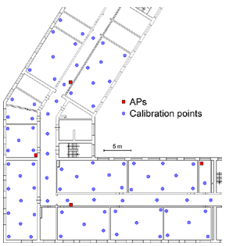

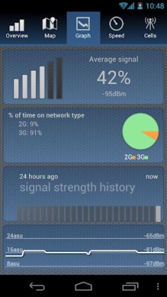
Reducing Measurements with Crowd Sourcing
Core Technology
WiFi-based fingerprinting
Adaptive technique to minimize labor-intensive site survey
Initial site survey
Need to be frequently updated by site surveys
Dynamically updated,
Reduced site survey

Slide 11
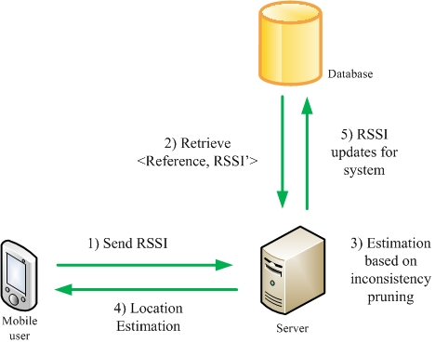

Our Chameleon System (New)
Pruning of inaccurate APs
Use only those unchanged signals to make location decision
Database update
Learn the environment and adapt the signal database accordingly

Slide 12
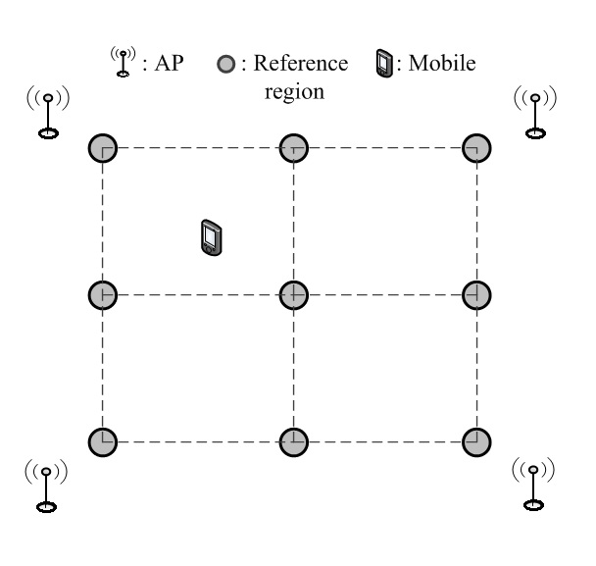
Simulation setup
N_{AP} APs are placed in a circle
N_{REF} reference points are placed in a grid with grid size g
Mobile collects and sends signal strength vector to server
Server estimates mobile’s location with a simple K-Nearest-Neighbor algorithm
(N_{AP}, N_{REF}, g, K) = (8, 9, 8m, 4)

